Slide 1


USA Border Crossing
Inbound Data
An Exploratory Data Analysis Project
Shaheda Choudhury, Rodi Tountcheva, Nha Nguyen, Gemma Verlezza-Ortega, Solomon Ejigu

Slide 2

What are we looking at?
“Border Crossing Entry Data”: The Bureau of Transportation - Kaggle, CSV with 23 years of crossing data.
Contains: 350,000 rows with 7 columns.
Columns: Port Name, State, Port Code, Border, Date, Measure, Value, Location
Notes:
Kraggle data link: https://www.kaggle.com/akhilv11/border-crossing-entry-data
Columns and it’s info
Port NameName of CBP Port of Entry
StateState
Port CodeCBP port code
BorderUS-Canada Border or US-Mexico Border
DateYear, Month
MeasureConveyances, containers, passengers, pedestrians
ValueCount
LocationLongitude and Latitude Location

Slide 3

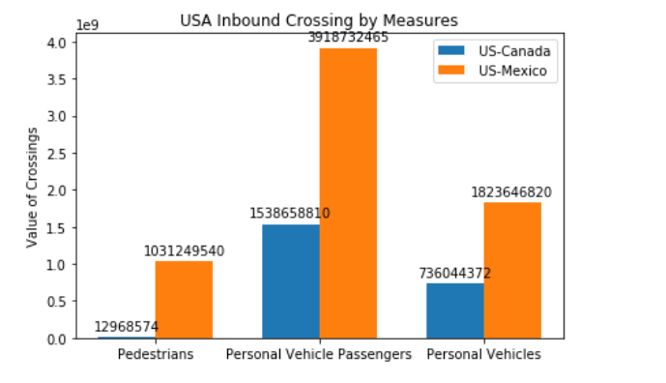
What is the total value of border crossings by single person mesures?
Notes:
Shaheda -
Clean up: 1. parsed the date into separate values columns 2. Created a loop which evaluated the measure rows in order to save the ones which match the 3 single person values I was looking for. 3. Created data frame to save the values and convert the indesis so that I can begin to plot.
Implications: This shows the number of people who come into the USA in single person values, the two colors shows the difference between the borders of the same measure of transportation. The value shows the numbers of recorded crossings for the last 23 years. In the future we cause use this same graph to look at the division in a yearly or monthly basis and can be also broken down more to individual ports in specific states if needed.

Slide 4

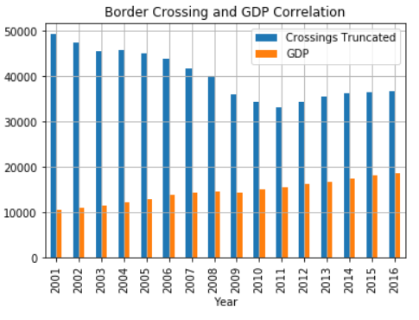
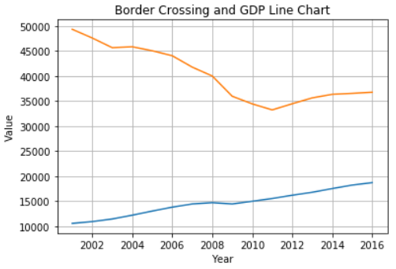
What is the correlation between US Gross Domestic Product (GDP) and border crossings?

Slide 5

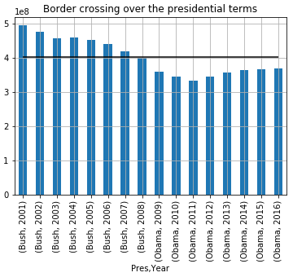
What is the relationships between US Presidents and legal border crossings?

Slide 6

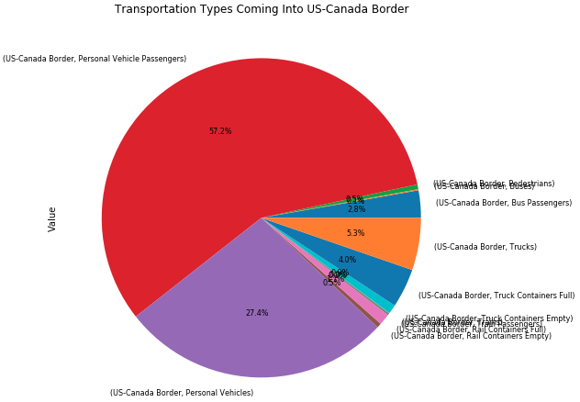
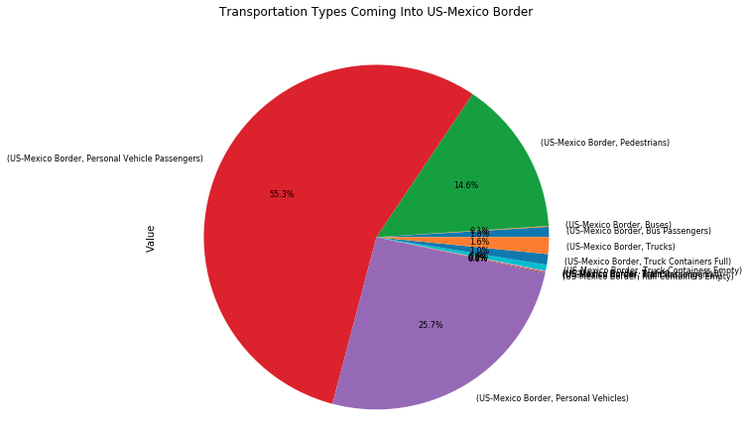
For each border with the USA, what is the transportation type that has the highest number coming in to that border?
Calculations
Implications
Graph
Notes:
Clean up: I cleaned up the data by grouping by border and measure and finding the sum of total value for each measure. Calculation of the sum of the value.
Implications: This shows the numbers of recorded crossings for the last 23 years. of each measure (type of transportation) who come into the USA for each border.

Slide 7

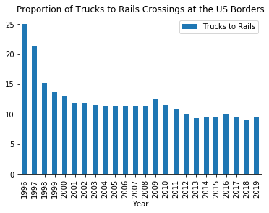
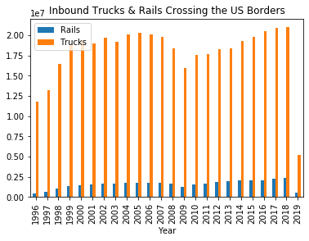
Question: How In-Bound Truck to Rail Crossing the US Borders Changed over the Years?
Notes:
Data Manipulation: Extracted & Filter selected data fields (drop), Combined data frames (append), Computed ratios of Truck to Rail (operations).
Answer: The RATIOs of Trucks to Rails cargo-load crossings declined over the years, except in 2008/9 and 2019, the periods of 2008/9 (recession) and 2019 (tariff changes)

Slide 8


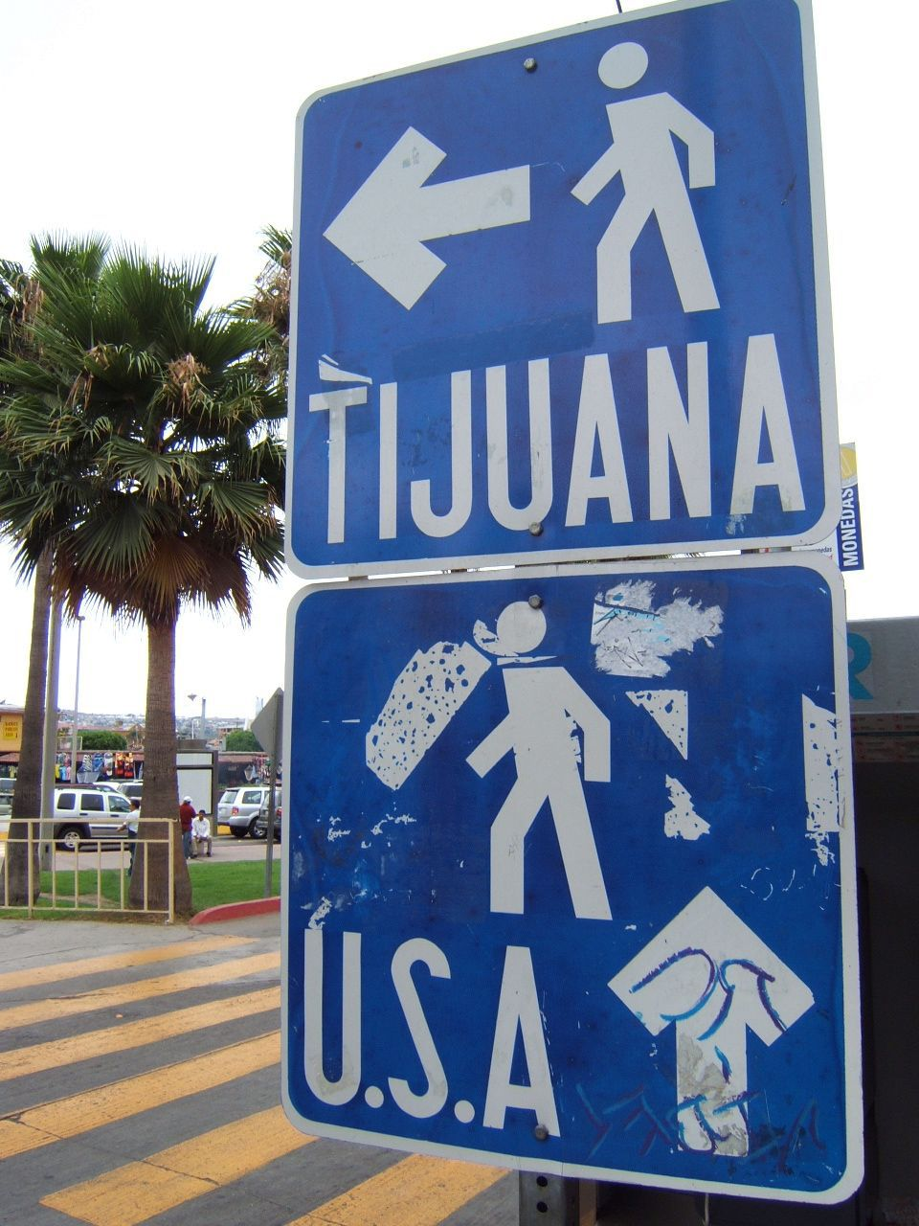
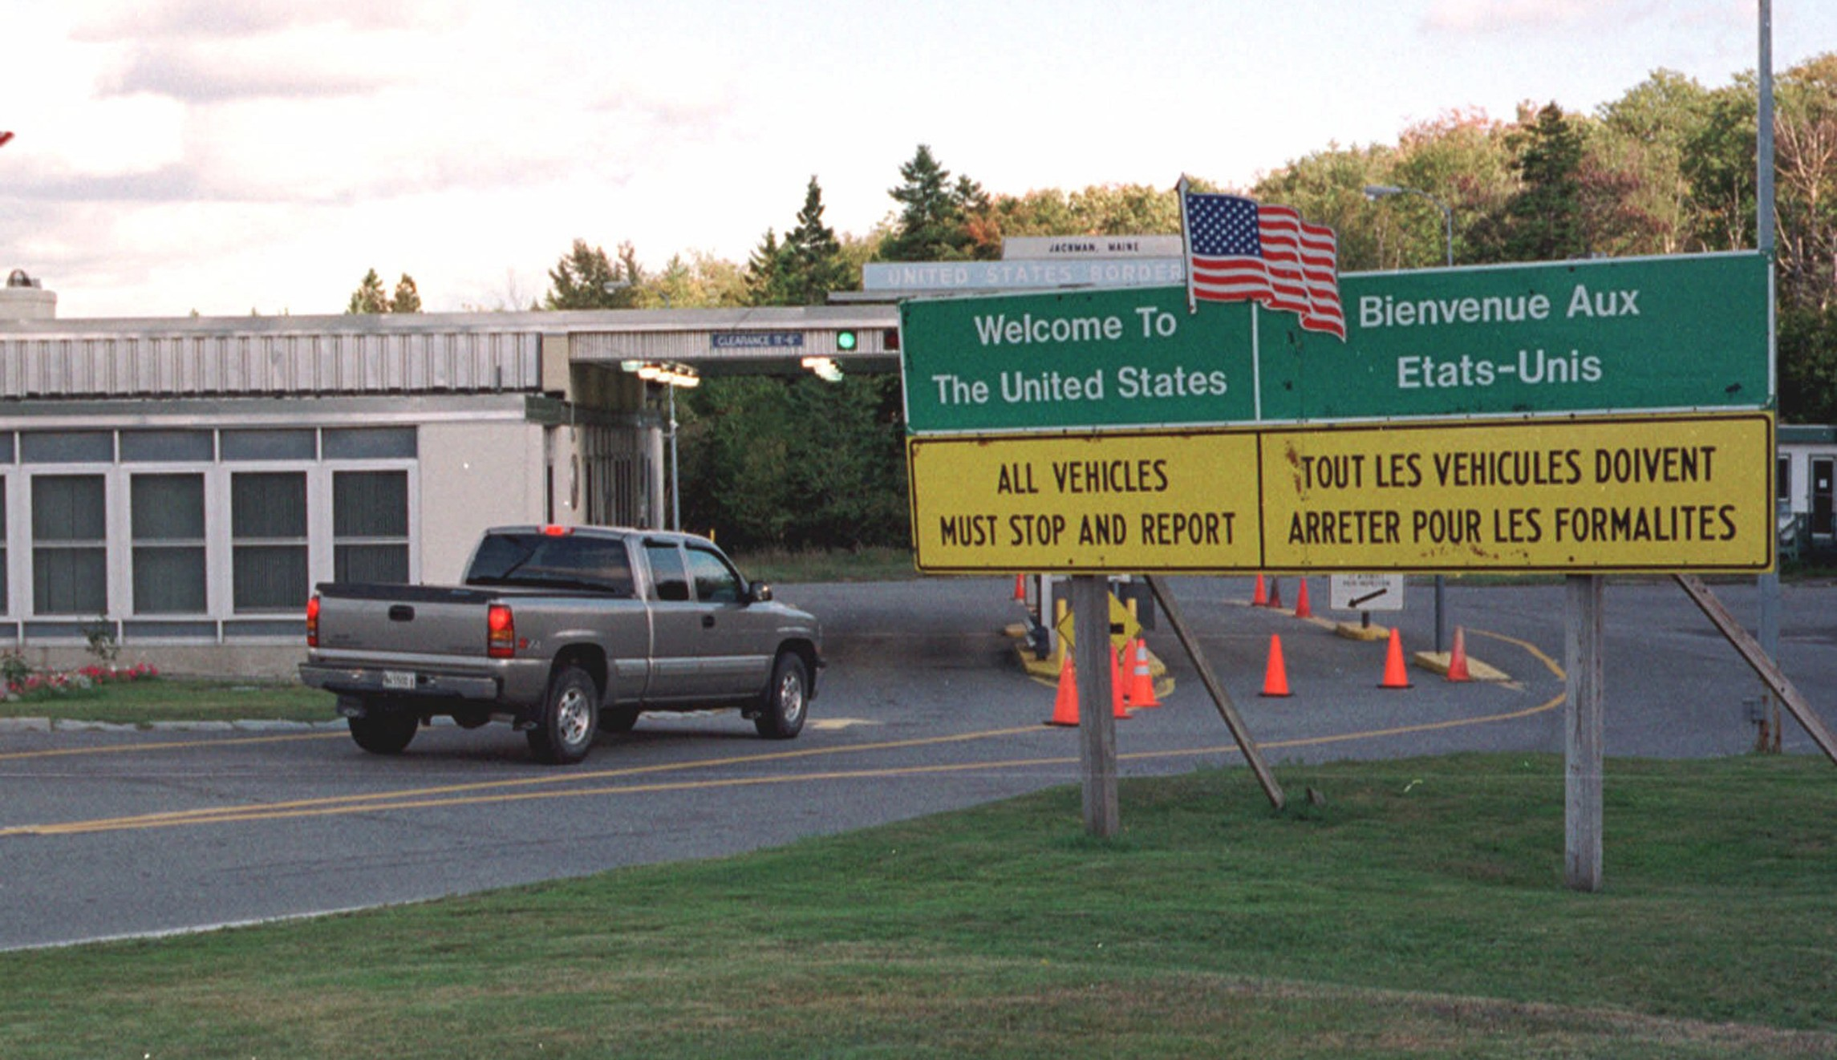

Je vous remercie!
Thank you!
iGracias!

